Slide 1

Diapositiva 1
Big Data Engineering
Anomaly Detection in Times Series

Slide 2





Diapositiva 10
Big Data Engineering
Anomaly Detection in Times Series
Raw Data
Data PreProcessing
What is Anomaly Detection
Collection of raw data from various sources
Preparation of Data for analysis and modeling
Result
Task that involves identifying unusual patterns that deviate from expected behavior.
Data Extraction
Deep Learning Model
Process of extracting relevant data from raw datasets
Building and training the deep learning model using the pre-processed data
1

Slide 3
Diapositiva 9
Workflow
Raw Data
Data PreProcessing
What is Anomaly Detection
Collection of raw data from various sources
Preparation of Data for analysis and modeling
Task that involves identifying unusual patterns that deviate from expected behavior.
Result
Data Extraction
Deep Learning Model
Process of extracting relevant data from raw datasets
Building and training the deep learning model using the pre-processed data
2

Slide 4
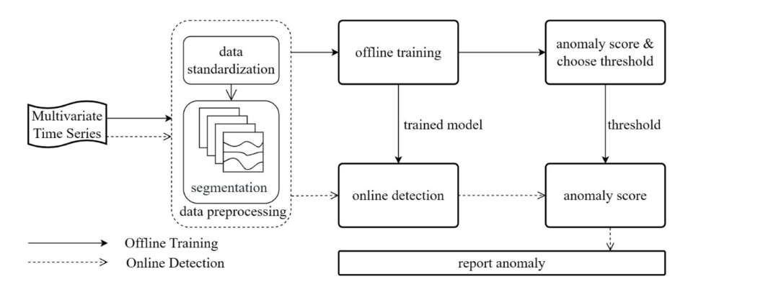
Workflow
3

Slide 5


Diapositiva 6
Dataset
17 variables
5mln instances
200 anomalous segments
Specific Features or Attributes of the collected data
Number of data points available
Each anomalous segment may contain a series of multiple anomalous data points
Controlled Anomalies Time Series (CATS)
The dataset consists of commands, external stimuli, and telemetry readings from a complex dynamic system.
4

Slide 6


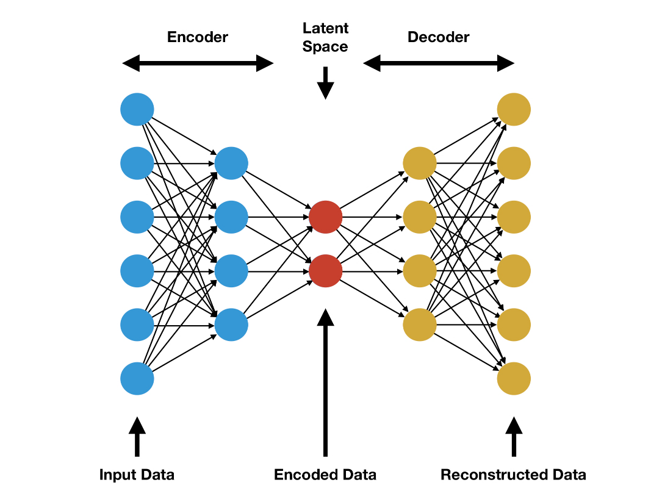
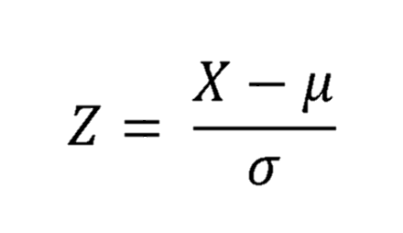
Diapositiva 6
17 variables
5mln instances
200 anomalous segments
Specific Features or Attributes of the collected data
Number of data points available
Each anomalous segment may contain a series of multiple anomalous data points
Data Standardization
Improve the convergence of optimization algorithms
Make the coefficients of the features more interpretable
Prevent features with different scales from disrupting the model
An autoencoder is a type of artificial neural network used to learn efficient encodings of unlabeled data (unsupervised learning).
Z-Score Normalization
Z-Score normalization is a technique used to rescale data to achieve the following:
Mean (𝜇) = 0
Standard deviation (𝜎) = 1
X is the original value of the feature
μ is the mean of the feature’s values
σ is the standard deviation of the feature’s values
5
Controlled Anomalies Time Series (CATS)
The dataset consists of commands, external stimuli, and telemetry readings from a complex dynamic system.

Slide 7
Diapositiva 7
An autoencoder is a type of artificial neural network used to learn efficient encodings of unlabeled data (unsupervised learning).
6

Slide 8
Diapositiva 7
Why an Autoencoder?
The autoencoder performs two functions:
An encoding function that transforms the input data (Encoder)
A decoding function that recreates the input data (Decoder)
When an anomalous input is received, the autoencoder fails to recreate it, recognizing it as anomalous.
7

Slide 9
Diapositiva 6
Hyperparameters
Optimizers
Epochs
Adam
RMSprop
30 epochs
60 epochs
Models
Thresholds
90th percentile of MSE on the training test
95th percentile of MSE on the training test
2 different Autoencoder architectures
8

Slide 10



Diapositiva 6
Model 1 vs Model 2
Model 1
Model 2
Apache Kafka is a distributed data streaming platform that allows publishing, subscribing, storing, and processing streams of records in real-time.
It is designed to handle data streams from multiple sources and distribute them to different consumers.
In essence, Kafka enables the movement of large amounts of data between multiple points simultaneously.
Model 1 is more complex:
Deeper
Includes Batch Normalization
Includes Dropout
5 encoding layers
5 decoding layers
Model 2 is simpler:
Less deep
No Batch Normalization
No Dropout
3 encoding layers
3 decoding layers
9

Slide 11
Diapositiva 7
Apache Kafka is a distributed data streaming platform that allows publishing, subscribing, storing, and processing streams of records in real-time.
It is designed to handle data streams from multiple sources and distribute them to different consumers.
In essence, Kafka enables the movement of large amounts of data between multiple points simultaneously.
10

Slide 12
Diapositiva 7
Using Kafka
Sending messages to Kafka topic
Starting Kafka server
Online anomaly detection
Training performed offline
11

Slide 13
Diapositiva 4
Results
Model 2
RMSprop
90th Percentile
Using Kafka
Sending messages to Kafka topic
Starting Kafka server
Online anomaly detection
Training performed offline
Model 2 displayed higher accuracy (simpler model)
RMSprop yielded better test results compared to Adam
The 90th percentile detected more anomalies but also returned more false positives
12
30 epochs displayed slightly higher accuracy

Slide 14
Diapositiva 2
Model 2
RMSprop
90th Percentile
Model 2 displayed higher accuracy (simpler model)
RMSprop yielded better test results compared to Adam
The 90th percentile detected more anomalies but also returned more false positives
Results
30 epochs displayed slightly higher accuracy
13

Slide 15

Diapositiva 11
Thank you for your attention

